Slide 1
Chapter 20
Programming a Heterogeneous Computing Cluster

Slide 2
MPI Model
Many processes distributed in a cluster
Each process computes part of the output
Processes communicate with each other
Processes can synchronize
Node
Node
Node
Node

Slide 3
MPI Initialization, Info and Sync
int MPI_Init(int *argc, char ***argv)
Initialize MPI
Also MPI_Finalize...
MPI_COMM_WORLD
MPI communicator with all allocated nodes
int MPI_Comm_rank(MPI_Comm comm, int *rank)
Rank of the calling process in group of comm
int MPI_Comm_size(MPI_Comm comm, int *size)
Number of processes in the group of comm

Slide 4
MPI Sending Data
int MPI_Send(void *buf, int count, MPI_Datatype datatype, int dest, int tag, MPI_Comm comm)
Buf: Initial address of send buffer (choice)
Count: Number of elements in send buffer (nonnegative integer)
Datatype: Datatype of each send buffer element (handle)
Dest: Rank of destination (integer)
Tag: Message tag (integer)
Comm: Communicator (handle)

Slide 5
MPI Sending Data
int MPI_Send(void *buf, int count, MPI_Datatype datatype, int dest, int tag, MPI_Comm comm)
Buf: Initial address of send buffer (choice)
Count: Number of elements in send buffer (nonnegative integer)
Datatype: Datatype of each send buffer element (handle)
Dest: Rank of destination (integer)
Tag: Message tag (integer)
Comm: Communicator (handle)
Node
Node
Node
Node

Slide 6
MPI Receiving Data
int MPI_Recv(void *buf, int count, MPI_Datatype datatype, int source, int tag, MPI_Comm comm, MPI_Status *status)
Buf: Initial address of receive buffer (choice)
Count: Maximum number of elements in receive buffer (integer)
Datatype: Datatype of each receive buffer element (handle)
Source: Rank of source (integer)
Tag: Message tag (integer)
Comm: Communicator (handle)
Status: Status object (Status)

Slide 7
MPI Receiving Data
int MPI_Recv(void *buf, int count, MPI_Datatype datatype, int source, int tag, MPI_Comm comm, MPI_Status *status)
Buf: Initial address of receive buffer (choice)
Count: Maximum number of elements in receive buffer (integer)
Datatype: Datatype of each receive buffer element (handle)
Source: Rank of source (integer)
Tag: Message tag (integer)
Comm: Communicator (handle)
Status: Status object (Status)
Node
Node
Node
Node

Slide 8
MPI Sending and Receiving Data
int MPI_Sendrecv(void *sendbuf, int sendcount, MPI_Datatype sendtype, int dest, int sendtag, void *recvbuf, int recvcount, MPI_Datatype recvtype, int source, int recvtag, MPI_Comm comm, MPI_Status *status)
Sendbuf: Initial address of send buffer (choice)
Sendcount: Number of elements in send buffer (integer)
Sendtype: Type of elements in send buffer (handle)
Dest: Rank of destination (integer)
Sendtag: Send tag (integer)
Recvcount: Number of elements in receive buffer (integer)
Recvtype: Type of elements in receive buffer (handle)
Source: Rank of source (integer)
Recvtag: Receive tag (integer)
Comm: Communicator (handle)
Recvbuf: Initial address of receive buffer (choice)
Status: Status object. This refers to the receive operation

Slide 9
MPI Sending and Receiving Data
int MPI_Sendrecv(void *sendbuf, int sendcount, MPI_Datatype sendtype, int dest, int sendtag, void *recvbuf, int recvcount, MPI_Datatype recvtype, int source, int recvtag, MPI_Comm comm, MPI_Status *status)
Sendbuf: Initial address of send buffer (choice)
Sendcount: Number of elements in send buffer (integer)
Sendtype: Type of elements in send buffer (handle)
Dest: Rank of destination (integer)
Sendtag: Send tag (integer)
Recvcount: Number of elements in receive buffer (integer)
Recvtype: Type of elements in receive buffer (handle)
Source: Rank of source (integer)
Recvtag: Receive tag (integer)
Comm: Communicator (handle)
Recvbuf: Initial address of receive buffer (choice)
Status: Status object. This refers to the receive operation
Node
Node
Node
Node

Slide 10
MPI Barriers
int MPI_Barrier(MPI_Comm comm)
Comm: Communicator (handle)
Blocks the caller until all group members have called it
The call returns at any process only after all group members have entered the call

Slide 11
MPI Barriers
Wait until all other processes in the MPI comm reach the same barrier
All processes are executing Do_Stuff()
Example Code
Do_stuff();
MPI_Barrier();
Do_more_stuff();
Node
Node
Node
Node

Slide 12
MPI Barriers
Wait until all other processes in the MPI comm reach the same barrier
All processes are executing Do_Stuff()
Some processes reach the barrier
Example Code
Do_stuff();
MPI_Barrier();
Do_more_stuff();
Node
Node
Node
Node

Slide 13
MPI Barriers
Wait until all other processes in the MPI comm reach the same barrier
All processes are executing Do_Stuff()
Some processes reach the barrier and then wait in the barrier
Example Code
Do_stuff();
MPI_Barrier();
Do_more_stuff();
Node
Node
Node
Node

Slide 14
MPI Barriers
Wait until all other processes in the MPI comm reach the same barrier
All processes are executing Do_Stuff()
Some processes reach the barrier and then wait in the barrier until all reach the barrier
Example Code
Do_stuff();
MPI_Barrier();
Do_more_stuff();
Node
Node
Node
Node

Slide 15
MPI Barriers
Wait until all other processes in the MPI comm reach the same barrier
All processes are executing Do_Stuff()
Some processes reach the barrier and then wait in the barrier until all reach the barrier
All processes execute Do_more_stuff()
Example Code
Do_stuff();
MPI_Barrier();
Do_more_stuff();
Node
Node
Node
Node

Slide 16
CUDA-based cluster
Each node contains N GPUs
GPU 1
…
GPU N
GPU 1
…
GPU N
PCIe
PCIe
PCIe
PCIe
CPU 1
…
CPU M
CPU 1
…
CPU M
Host Memory
Host Memory
Notes:
There are two alternatives:
1- A MPI process per computational resource (e.g. core)
· Some overhead is involved due to MPI calls to communicate processors with support for shared memory
· The same programming model is used for all resources
2- A MPI process per node
· Other abstractions are used to manage all the computational resources within a node
· Lower overhead, more complexity

Slide 17
CUDA and MPI Communication
Source MPI process:
cudaMemcpy(tmp, src, cudaMemcpyDeviceToHost)
MPI_Send(tmp, ...)
Destination MPI process:
MPI_Recv(tmp, ...)
cudaMemcpy(dst, tmp, cudaMemcpyHostToDevice)
MPI Process N
Device Memory
GPU 0
MPI Process N + 1
Device Memory
GPU 1
Notes:
MPI targets CPU codes
1- Only handle the host memory space
2- Cannot communicate GPUs directly

Slide 18


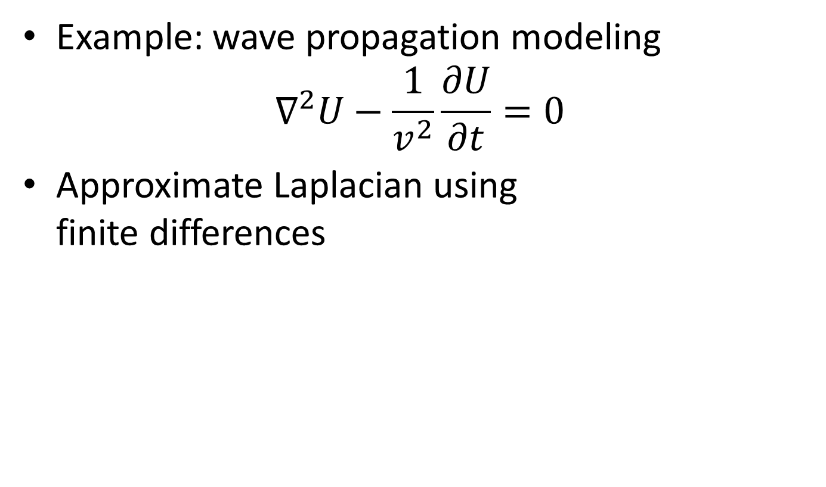
Review of Stencil Computations
Example: wave propagation modeling
$$∇^{2}U−\frac{1}{v^{2}}\frac{∂U}{∂t}=0$$
Approximate Laplacian using finite differences

Slide 19
Stencil Domain Decomposition
Volumes are split into tiles (along the Z-axis)
3D-Stencil introduces data dependencies
D2
D4
x
y
z
D1
D3
Notes:
Go back to the RTM example what the data server process is going to do is distributing the different parts of the data (subdomains) to each worker process
- Data decomposition is performed in the Z dimension so that partitions are contiguous in memory.
- Remind that 3D stencil introduces dependencies.
· Points in the boundary of one domain need points that reside in the neighboring domain
· After each simulation step, boundaries need to be exchanged between domains

Slide 20
Boundary Exchange Example (I)
Approach: two-stage execution
Stage 1: compute the field points to be exchanged
x
y
z
GPU1
GPU2
Notes:
First step is exactly the same as in intra-node. Each process launches a kernel that computes the points in the boundaries
Copy from GPU to CPU memory + MPI exchange
- Involves cudaMemcpy to host + MPI_sendreceive + cudaMemcpy to device
- Critical to overlap these operations, because costs are higher

Slide 21
Boundary Exchange Example (II)
Approach: two-stage execution
Stage 2: Compute the remaining points while exchanging the boundaries
x
y
z
GPU1
GPU2

Slide 22
Stencil Code: Compute Process (IV)
for(int i=0; i < nreps; i++) {
/* Compute values needed by other nodes first */
launch_kernel(d_output + left_stage1_offset,
d_input + left_stage1_offset, dimx, dimy, 12, stream1);
launch_kernel(d_output + right_stage1_offset,
d_input + right_stage1_offset, dimx, dimy, 12, stream1);
/* Compute the remaining points */
launch_kernel(d_output + stage2_offset, d_input + stage2_offset,
dimx, dimy, dimz, stream2);
/* Copy the data needed by other nodes to the host */
cudaMemcpyAsync(h_left_ghost_own,
d_output + num_ghost_points,
num_ghost_bytes, cudaMemcpyDeviceToHost, stream1);
cudaMemcpyAsync(h_right_ghost_own,
d_output + right_stage1_offset + num_ghost_points,
num_ghost_bytes, cudaMemcpyDeviceToHost, stream1);
cudaStreamSynchronize(stream1);

Slide 23
Stencil Code: Compute Process (V)
/* Send data to left, get data from right */
MPI_Sendrecv(h_left_ghost_own, num_ghost_points, MPI_REAL,
left_neighbor, i,
h_right_ghost, num_ghost_points, MPI_REAL,
right_neighbor, i,
MPI_COMM_WORLD, &status);
/* Send data to right, get data from left */
MPI_Sendrecv(h_right_ghost_own, num_ghost_points, MPI_REAL,
right_neighbor, i,
h_left_ghost, num_ghost_points, MPI_REAL,
left_neighbor, i,
MPI_COMM_WORLD, &status);
cudaMemcpyAsync(d_output+left_ghost_offset, h_left_ghost,
num_ghost_bytes, cudaMemcpyHostToDevice, stream1);
cudaMemcpyAsync(d_output+right_ghost_offset, h_right_ghost,
num_ghost_bytes, cudaMemcpyHostToDevice, stream1);
cudaDeviceSynchronize();
float *temp = d_output;
d_output = d_input; d_input = temp;
}
All streams synced

Slide 24
CUDA-Aware MPI
Several MPI implementations provide optimized CUDA paths
Understand CUDA pointers (no intermediate copies!)
Different nodes: Optimized GPU-network pipelined transfers
GPUDirect RDMA if available
Same node: Use shared memory across processes
cudaIpc{Open,Get,Close}MemHandle
No internal intermediate copies!
Available
OpenMPI >= 1.7
MVAPICH2 >= 1.8
CRAY MPI >= MPT 5.6.2
IBM Platform MPI >= 8.3
SGI MPI >= 1.08

Slide 25
Stencil Code: Compute Process (IV) CUDA-aware MPI
for(int i=0; I < nreps; i++) {
/* Compute values needed by other nodes first */
launch_kernel(d_output + left_stage1_offset,
d_input + left_stage1_offset, dimx, dimy, 12, stream1);
launch_kernel(d_output + right_stage1_offset,
d_input + right_stage1_offset, dimx, dimy, 12, stream1);
/* Compute the remaining points */
launch_kernel(d_output + stage2_offset, d_input + stage2_offset,
dimx, dimy, dimz, stream2);
/* Wait for points in the boundary to be computed */
cudaStreamSynchronize(stream1);

Slide 26
Stencil Code: Compute Process (V) CUDA-aware MPI
/* Send data to left, get data from right */
MPI_Sendrecv(d_output+num_ghost_points, num_ghost_points,
MPI_REAL, left_neighbor, i,
d_output+right_ghost_offset, num_ghost_points,
MPI_REAL, right_neighbor, i,
MPI_COMM_WORLD, &status);
/* Send data to right, get data from left */
MPI_Sendrecv(d_output+right_stage1_offset+num_ghost_points,
num_ghost_points, MPI_REAL,
right_neighbor, i,
d_output+left_ghost_offset, num_ghost_points,
MPI_REAL, left_neighbor, i,
MPI_COMM_WORLD, &status);
cudaStreamSynchronize(stream2);
float *temp = d_output;
d_output = d_input; d_input = temp;
}-

Slide 27
CUDA and MPI
MPI Processes can handle more than one GPU
Peer GPU-to-GPU communication without need for MPI
Several MPI processes sharing the same GPU introduce context switch overheads....
... but Hyper-Q in Kepler greatly reduces such overheads
Device Memory
GPU 0
MPI Process N
Device Memory
GPU 1

Slide 28
References
Wen-mei W. Hwu, David B. Kirk, and Izzat El Hajj. Programming Massively Parallel Processors: A Hands-on Approach. Morgan Kaufmann, 2022.

